Slide 1


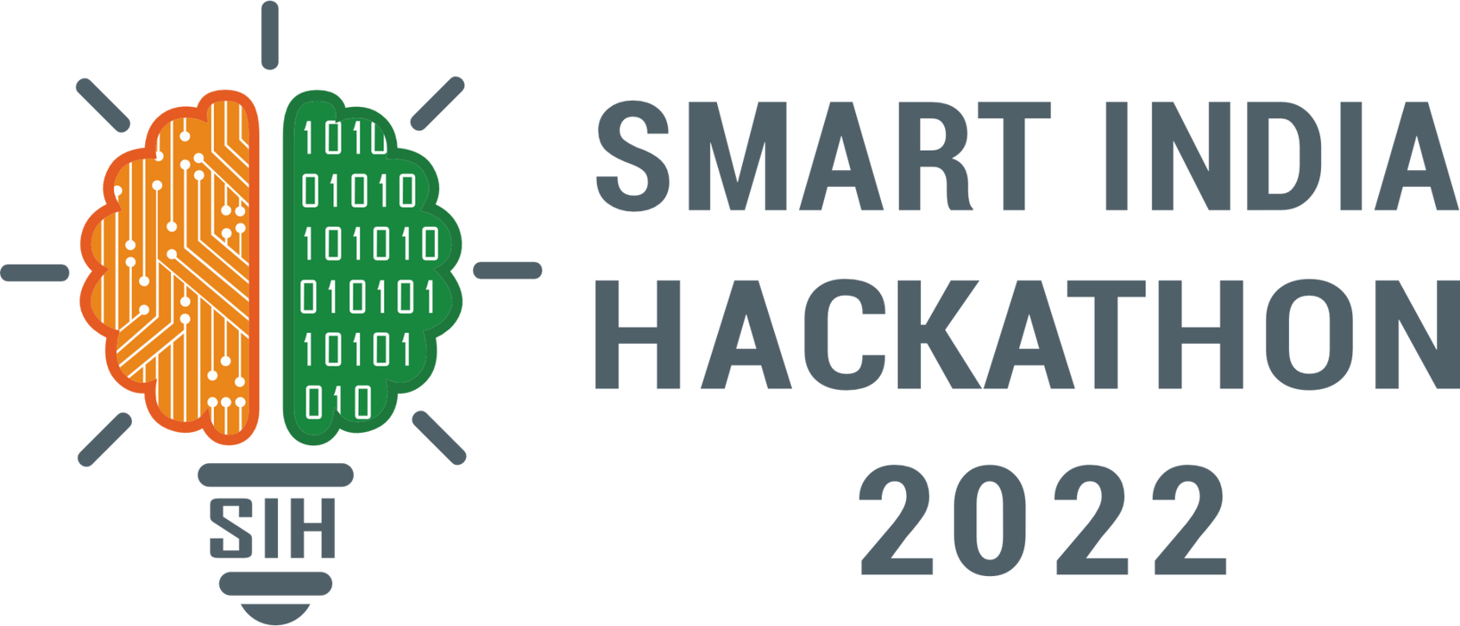
SMART INDIA HACKATHON 2025
TITLE PAGE
Problem Statement ID –SIH25137
Problem Statement Title- Student Innovation
Theme-Travel & Tourism
PS Category- Software
Team ID-
Team Name (Registered on portal) : TourMate- Smart Travel Companion

Slide 2




Travel & Tourism
TourMate
Proposed Solution :
Problem Statement:
Proposed Solution:
“India’s tourism and hospitality sector, though vital to the economy, faces slow recovery due to pandemic impacts, outdated digital systems, and unmet traveler expectations, leaving hotels and agencies with low occupancy, poor personalization, and fragmented services.”
Unified platform for hotels, travel agencies & attractions
AI personalization for trips, offers & recommendations
Seamless booking & support across devices
Local experience integration to promote culture & community
$178B GDP in 2021, projected $512B by 2028 (WTTC)
Supports 42M+ jobs in India
70% travelers prefer digital-first planning & booking (McKinsey)
Target Audience :
@SIH Idea submission- Template
2

Slide 3
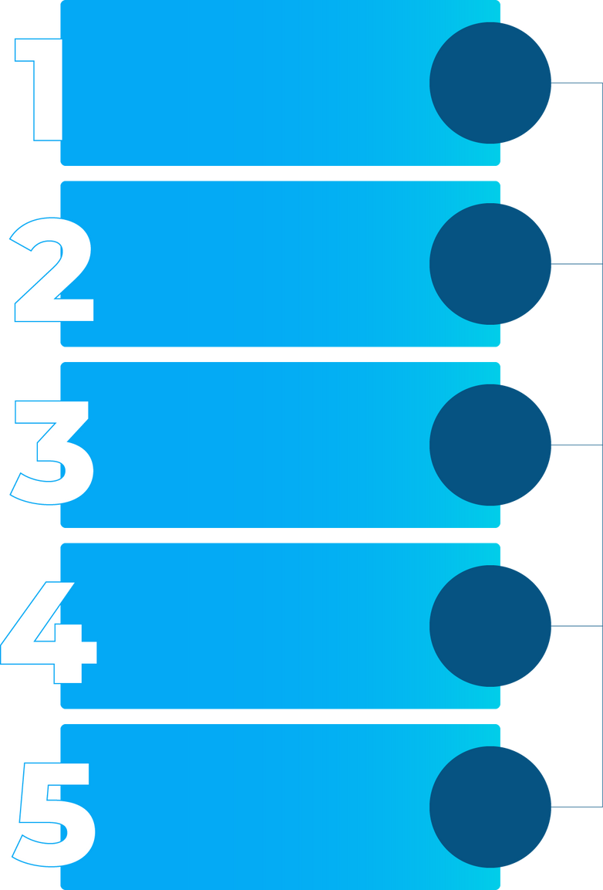

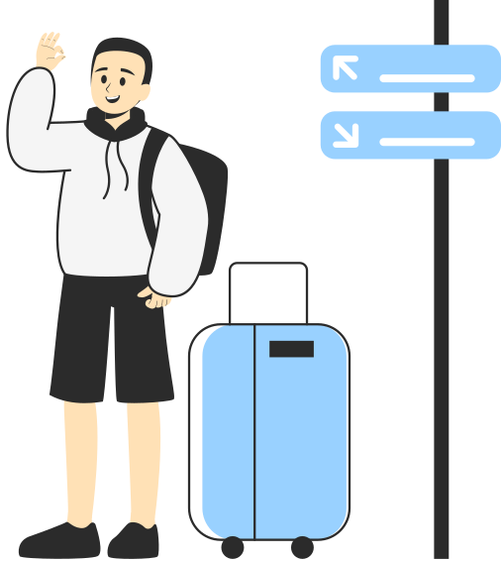




TECHNICAL APPROACH
TourMate
Mobile App
INPUT:
Frontend
OUTPUT:
User Input Layer
Destination
Budget (Low/Med/High)
Duration of Stay
Interest Type (Adventure/Beaches/Food/Heritage)
Destination, Budget, Preferences
Shows Tourist Spots list (Top 3–5 suggestions).
Shows Hotels & Stay Options (names, ratings).
Shows Map View / Itinerary Preview.
Can also place a prototype screenshot or placeholder image (like in sample, where they had a video).
Processing Layer
AI Recommendation Engine: Travel suggestions, itinerary logic
Technologies
Database Layer
Python
Flask/Django
TensorFlow / Scikit-learn
Google Maps API
MySQL / Firebase
React / JavaScript
Tourist spots dataset, Hotels info, APIs for maps/booking
Output Layer
Recommendations displayed to user.
@SIH Idea submission- Template
3

Slide 4

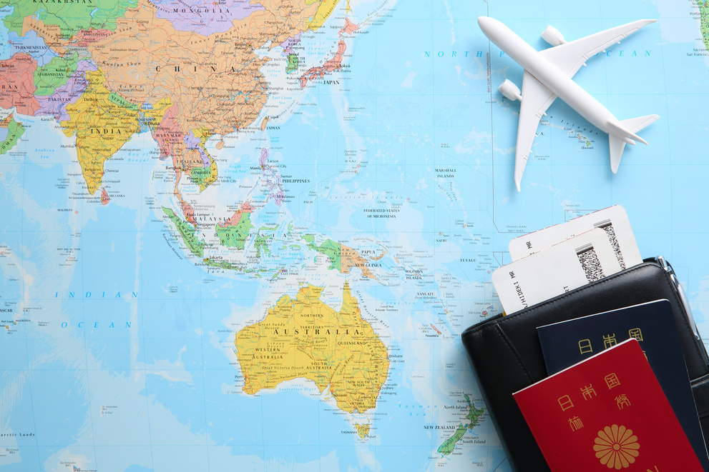
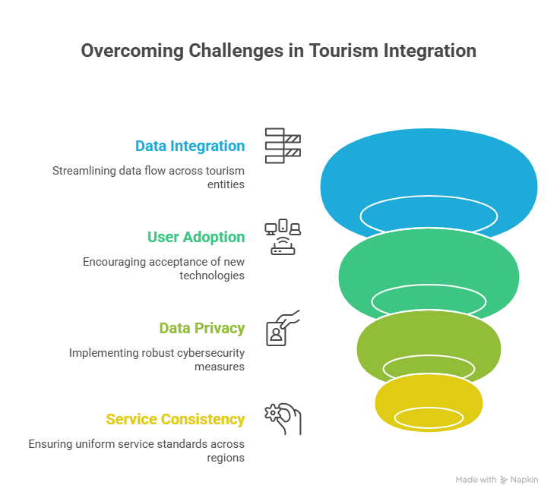

FEASIBILITY AND VIABILITY
TourMate
Technical
Feasibility
Operational
Feasibility
✅ Cloud-based platform ensures scalability & reliability
✅ AI/ML models for personalization & recommendation systems
✅ API integrations with hotels, travel agencies, and payment gateways
✅ Mobile & web apps for seamless user experience
⚙️ Easy adoption by hotels, agencies, and local businesses
⚙️ User-friendly design lowers learning curve for stakeholders
⚙️ Revenue through subscription, commission, or partnership models
⚙️ Supports government initiatives like Digital India & Smart Tourism
@SIH Idea submission- Template
4

Slide 5
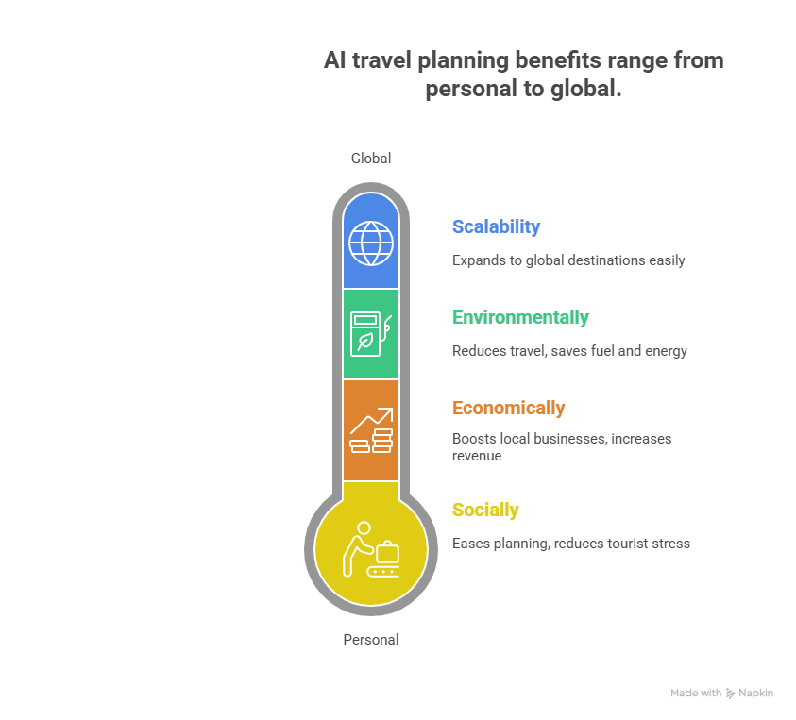


IMPACT AND BENEFITS
TourMate
Impact
Socially: Makes travel planning easier, reduces stress for tourists.
Economically: Boosts local businesses (hotels, restaurants, guides).
Environmentally: AI-based itinerary reduces unnecessary travel, saves fuel/energy.
Benefits
Efficiency: Quick, AI-driven personalized recommendations.
Cost-effectiveness: Helps tourists find budget-friendly options.
Scalability: Can expand to global destinations easily.
User-Friendly: Intuitive UI, multilingual support.
Innovation: Combines travel APIs + AI to give a new edge.
@SIH Idea submission- Template
5

Slide 6
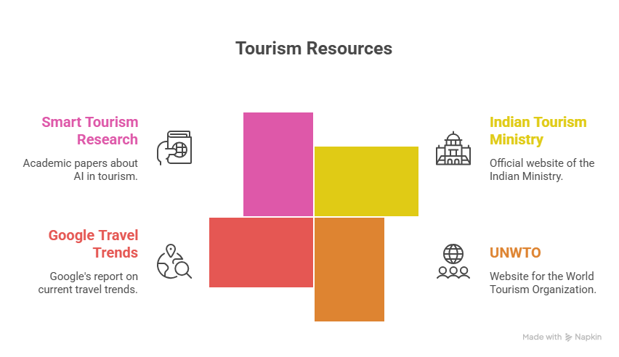
RESEARCH AND REFERENCES
TourMate
Research papers on Smart Tourism & AI in Travel (IEEE, Springer)
Ministry of Tourism, Govt. of India – tourism.gov.in
Google Travel Trends Report 2024 – thinkwithgoogle.com
World Tourism Organization (UNWTO) – unwto.org
@SIH Idea submission- Template
6

